Slide 1

DIABETES PREDICTION SYSTEM USING MACHINE LEARNING

Slide 2
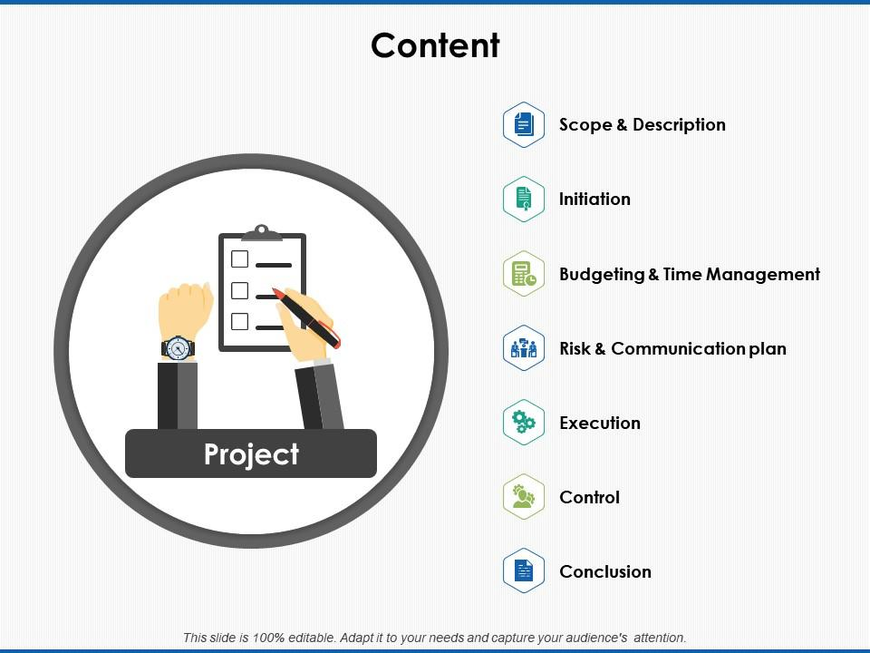
Contents
Introduction
Objectives
Algorithm
Working of KNN
Data Collection
Data Preprocessing
Implementation
Snapshots
Output page
Future scope

Slide 3
INTRODUCTION
Diabetes mellitus, commonly known as diabetes, is a chronic diseases.
characterized by high levels of blood glucose (hyperglycemia) over a prolonged period.
Diabetes can be categorized into two types: Type 1 diabetes and Type 2 diabetes
Type 1 : This occurs when the immune system mistakenly attacks and destroys the insulin-producing beta cells in the pancreas.
Type 2 : This is the most prevalent form of diabetes, accounting for the majority of cases worldwide.

Slide 4
OBJECTIVES
The primary objective of the diabetes prediction system is to identify individuals at risk of developing diabetes at an early stage. Early detection allows for timely interventions, lifestyle modifications, and preventive measures to mitigate the progression of the disease and reduce the risk of complications.
Early Intervention and Prevention.
Reduced Healthcare Burden.

Slide 5
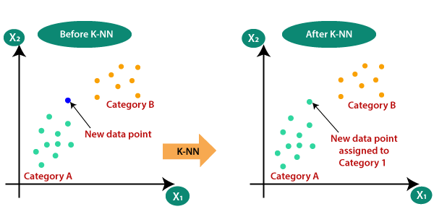
ALGORITHM
In this project we use KNN algorithm to predict our model.
The k-Nearest Neighbors (k-NN) algorithm is a simple yet effective supervised machine learning technique used for classification and regression tasks. In classification tasks, it is particularly useful for identifying the class of a new data point based on the majority class of its nearest neighbors in the feature space.

Slide 6
WORKING OF KNN
1. Training Phase: During the training phase, the algorithm simply stores all available data points along with their corresponding class labels.
2. Prediction Phase:
Given a new data point, the algorithm calculates its distance to all other data points in the training set. The most commonly used distance metric is Euclidean distance, although other metrics like Manhattan or cosine distance can also be used.
It then selects the k nearest data points (neighbors) to the new data point based on the calculated distances.
For classification, the algorithm assigns the class label that is most frequent among the k nearest neighbors to the new data point. In regression tasks, it computes the average (or weighted average) of the target values of the k nearest neighbors and assigns it as the predicted value for the new data point.

Slide 7
DATA COLLECTION
Sources of data (https://www.kaggle.com/datasets/iammustafatz/diabetes-prediction-dataset)
Features used in project
Pregnancies: This variable represents the number of times a woman has been pregnant.
Glucose: Plasma glucose concentration a 2 hours in an oral glucose tolerance test.
Blood Pressure: This variable represents the diastolic blood pressure (mm Hg) of the individual.
Skin Thickness: This variable indicates the thickness of the triceps skin fold in millimeters.
Insulin: This variable represents the 2-hour serum insulin level measured in micro units per milliliter (mu U/ml) during a glucose tolerance test.
BMI: Body Mass Index (BMI) is calculated as the individual's weight in kilograms divided by the square of their height in meters.
Diabetes Pedigree Function: This variable is a function that represents the likelihood of diabetes based on family history. It combines information about the diabetes history of relatives and the age of onset to provide a numerical value indicating genetic predisposition to diabetes.
Age: Age is the age of the individual in years.
Outcome: This variable is a binary indicator (0 or 1) representing the presence or absence of diabetes. A value of 1 typically indicates that the individual has been diagnosed with diabetes, while a value of 0 indicates no diagnosis.

Slide 8
DATA PREPROCESSING
Data Cleaning Steps:
Handling Missing Values:
Identify and assess missing values in the dataset.
Handling Outliers:
Identify outliers, which are data points that significantly deviate from the rest of the dataset.
Feature Scaling and Normalization:
Feature Scaling:
Normalize the scale of features to ensure that all features contribute equally to model training.
Normalization:
Normalize the distribution of features to make them comparable and easier for the model to interpret.
Ensuring Data Quality for Model Training:
Validation and Verification:
Validate the integrity and accuracy of the dataset through rigorous validation processes.

Slide 9
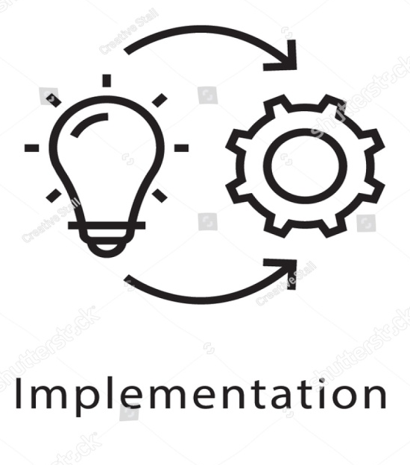
IMPLEMENTATION
Tools and technique used in project
Programming language: Python
Data analysis: Pandas , Scikit-learn
Data visualization: Matplotlib
Integrated Development Environments (IDEs): Vs code
Data Preprocessing Tools: Excel
Cloud Computing Platforms : Google colab
Deployment: Flask

Slide 10
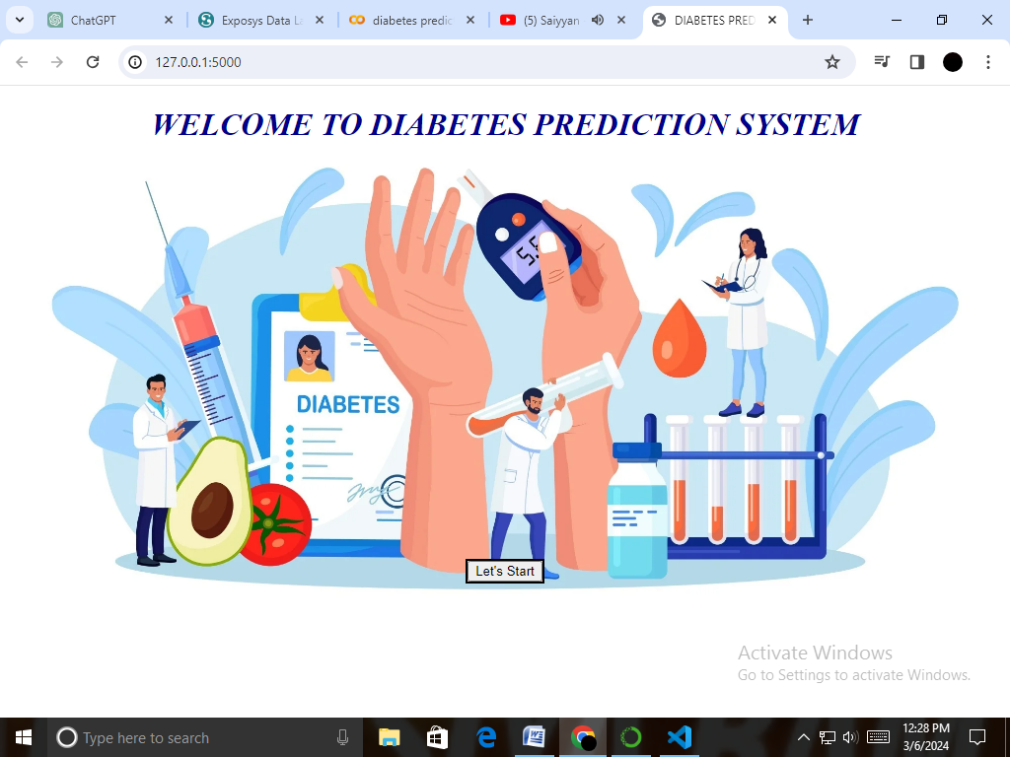
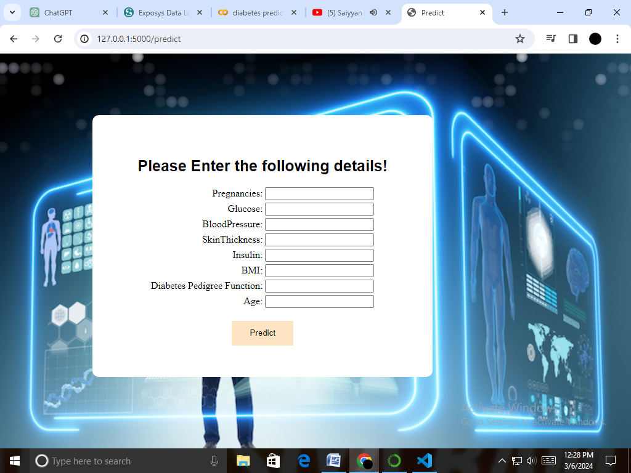
HOME PAGE
LOGIN PAGE

Slide 11
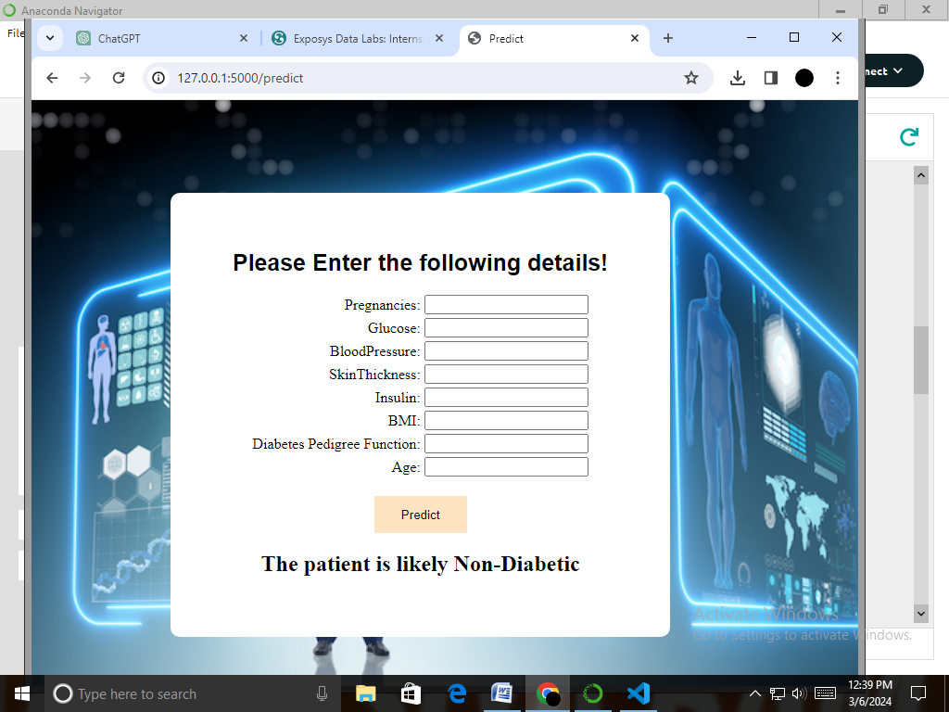
OUTPUT PAGE
PREDICTION

Slide 12
FUTURE SCOPE
Add more sophisticated machine learning algorithms for comparison.
Enhance the user interface with more features or better styling.
Deploy the application to a production server for public access

Slide 13


